Slide 1
Cloning Strategy Using PCR
Brian Wiley
Bio212AA – Fall 2018

Slide 2
Description
The goal of the cloning project is to successfully amplify GOI from plasmid DNA through PCR and then digest plasmids and the GOI to insert into plasmid.
We can then transform bacteria and grow the plasmid with the inserted GOI to make a lot of that GOI.
Reason we use plasmid vectors instead of the entire plasmid that have the GOI is because if the plasmid containing the GOI is very large transformation efficiency decreases.
We can also insert more then one GOI.
Better to do sequentially then all at once.

Slide 3
Practical Uses
Agriculture and GMO
Medicine:
Protein Hormones – Insulin
Vitamins
Antibiotics
Creating Gene Libraries
Gene Therapy – Correcting Genetic Disorders
Germ (ethical issues) or Somatic

Slide 4
Major Steps
Transformation and miniprep of plasmid vector and insert vector with GOI
Amplification of GOI using PCR and Primers
Digest of Plasmid Vector, Purification, Phosphatase Treatment
Purification of PCR Reactions, Restriction Digest of PCR, and Purification
Ligation
Transformation
Pick and Grow Colonies
Miniprep and Restriction Digest

Slide 5
Transformation and midiprep of plasmid vector and insert vector with GOI
Amplification of GOI using PCR and Primers
Digest of Plasmid Vector and Purification
Purification of PCR Reactions, Restriction Digest of PCR, and Purification
Ligation
Transformation
Pick and Grow Colonies
Miniprep and Restriction Digest

Slide 6
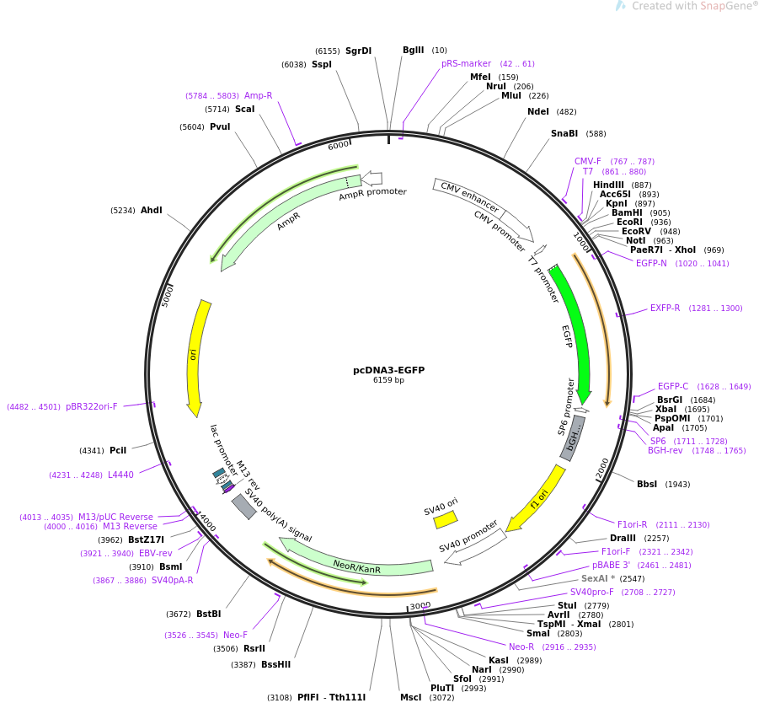
Transformation and Midiprep for Plasmid and GOI Vector
Transformation of chemically competent cells
Requires plating and picking colonies – AmpR
Grow colonies in LB
Midiprep of all 4 plasmids:
MK3 to go into pCIP
EGFP to go into pUC19
https://www.addgene.org/13031/

Slide 7
Transformation and miniprep of plasmid vector and insert vector with GOI
Amplification of GOI using PCR and Primers
Digest of Plasmid Vector and Purification
Purification of PCR Reactions, Restriction Digest of PCR, and Purification
Ligation
Transformation
Pick and Grow Colonies
Miniprep and Restriction Digest

Slide 8
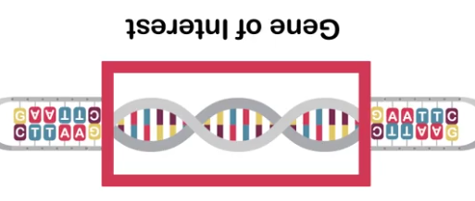
Amplification of GOI using PCR and Primers
Reason: Must amplify the entire gene of interest from the beginning start codon to end codon so gene can be expressed into protein.
Use of two restriction enzyme primers, forward and reverse, prevents inversion of GOI into the plasmid DNA later on.
https://www.coursera.org/learn/dna-decoded/lecture/k2gYI/slice-and-dice-restriction-enzymes
7:55 to 8:55

Slide 9

Amplification of GOI using PCR and Primers
PCR Master Mix
50 µL total for each tube (8 tubes)
Template DNA – 1 µL
Forward Primer – 2 µL
Reverse Primer – 2 µL
Deoxyribonucleotide triphosphates (A, C, G, T) – 1 µL
10x Taq Buffer – 5 µL
H₂0 – 38.6 µL
Taq (Thermus Aquaticus) Enzyme – 0.4
https://sites.psu.edu/pashun/2017/10/06/thermus-aquaticus/

Slide 10
Amplification of GOI using PCR and Primers
Forward Primer for EGFP (5’ to 3’) EcoR1
CACAGAATTCCCATGGTGAGCAAGGGCGAGGAG
Reverse Primer for EGFP (5’ to 3’) BamH1
CACAGGATCCCCTTACTTTGTACAGCTCGTCATGCCGA
Round 1 PCR
5’ ATGGTGAGCAAGGGCGAGGAG……TCGGCATGACGAGCTGTACAAAGTAAGGGGATCCTGTG 3’
3’ TACCACTCGTTCCCGCTCCTC……AGCCGTACTGCTCGACATGTTTCATTCCCCTAGGACAC 5’
5’ CACAGAATTCCCATGGTGAGCAAGGGCGAGGAG……TCGGCATGACGAGCTGTACAAAGTAA 3’
3’ GTGTCTTAAGGGTACCACTCGTTCCCGCTCCTC……AGCCGTACTGCTCGACATGTTTCATT 5’
Round 2 PCR
5’ ATGGTGAGCAAGGGCGAGGAG……TCGGCATGACGAGCTGTACAAAGTAAGGGGATCCTGTG 3’
3’ TACCACTCGTTCCCGCTCCTC……AGCCGTACTGCTCGACATGTTTCATTCCCCTAGGACAC 5’
3’ GTGTCTTAAGGGTACCACTCGTTCCCGCTCCTC……AGCCGTACTGCTCGACATGTTTCATTCCCCTAGGACAC 5’
5’ CACAGAATTCCCATGGTGAGCAAGGGCGAGGAG……TCGGCATGACGAGCTGTACAAAGTAAGGGGATCCTGTG 3’
5’ CACAGAATTCCCATGGTGAGCAAGGGCGAGGAG……TCGGCATGACGAGCTGTACAAAGTAAGGGGATCCTGTG 3’
3’ GTGTCTTAAGGGTACCACTCGTTCCCGCTCCTC……AGCCGTACTGCTCGACATGTTTCATTCCCCTAGGACAC 5’
3’ GTGTCTTAAGGGTACCACTCGTTCCCGCTCCTC……AGCCGTACTGCTCGACATGTTTCATT 5’
5’ CACAGAATTCCCATGGTGAGCAAGGGCGAGGAG……TCGGCATGACGAGCTGTACAAAGTAA 3’
2/4

Slide 11
Round 3
Round 3
5’ ATGGTGAGCAAGGGCGAGGAG……TCGGCATGACGAGCTGTACAAAGTAAGGGGATCCTGTG 3’
3’ TACCACTCGTTCCCGCTCCTC……AGCCGTACTGCTCGACATGTTTCATTCCCCTAGGACAC 5’
3’ GTGTCTTAAGGGTACCACTCGTTCCCGCTCCTC……AGCCGTACTGCTCGACATGTTTCATTCCCCTAGGACAC 5’
5’ CACAGAATTCCCATGGTGAGCAAGGGCGAGGAG……TCGGCATGACGAGCTGTACAAAGTAAGGGGATCCTGTG 3’
3’ GTGTCTTAAGGGTACCACTCGTTCCCGCTCCTC……AGCCGTACTGCTCGACATGTTTCATTCCCCTAGGACAC 5’
5’ CACAGAATTCCCATGGTGAGCAAGGGCGAGGAG……TCGGCATGACGAGCTGTACAAAGTAAGGGGATCCTGTG 3’
5’ CACAGAATTCCCATGGTGAGCAAGGGCGAGGAG……TCGGCATGACGAGCTGTACAAAGTAAGGGGATCCTGTG 3’
3’ GTGTCTTAAGGGTACCACTCGTTCCCGCTCCTC……AGCCGTACTGCTCGACATGTTTCATTCCCCTAGGACAC 5’
5’ CACAGAATTCCCATGGTGAGCAAGGGCGAGGAG……TCGGCATGACGAGCTGTACAAAGTAAGGGGATCCTGTG 3’
3’ GTGTCTTAAGGGTACCACTCGTTCCCGCTCCTC……AGCCGTACTGCTCGACATGTTTCATTCCCCTAGGACAC 5’
3’ GTGTCTTAAGGGTACCACTCGTTCCCGCTCCTC……AGCCGTACTGCTCGACATGTTTCATTCCCCTAGGACAC 5’
5’ CACAGAATTCCCATGGTGAGCAAGGGCGAGGAG……TCGGCATGACGAGCTGTACAAAGTAAGGGGATCCTGTG 3’
3’ GTGTCTTAAGGGTACCACTCGTTCCCGCTCCTC……AGCCGTACTGCTCGACATGTTTCATT 5’
5’ CACAGAATTCCCATGGTGAGCAAGGGCGAGGAG……TCGGCATGACGAGCTGTACAAAGTAA 3’
5’ CACAGAATTCCCATGGTGAGCAAGGGCGAGGAG……TCGGCATGACGAGCTGTACAAAGTAAGGGGATCCTGTG 3’
3’ GTGTCTTAAGGGTACCACTCGTTCCCGCTCCTC……AGCCGTACTGCTCGACATGTTTCATTCCCCTAGGACAC 5’
6/8

Slide 12
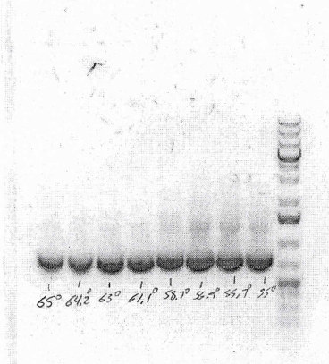
PCR Tests and Results
EGFP Results
November 5, 2018
EGFP at temperature gradient in °C (65, 64.2, 63, 61.1, 58.7, 56.9, 55.7, 55)
PCR Worked
MK3 no DMSO at temperature gradient in °C (65, 64.2, 63, 61.1, 58.7, 56.9, 55.7, 55)
PCR Did not Work
November 14, 2018
MK3 2% DMSO at temperature gradient in °C (65, 64.2, 63, 61.1, 58.7, 56.9, 55.7, 55)
PCR Did not Work
November 14, 2018
MK3 3% and 5% DMSO at temperature gradient in °C (65, 64.2, 63, 61.1, 58.7, 56.9, 55.7, 55)
PCR Did not Work

Slide 13
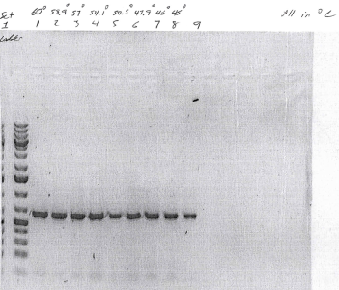
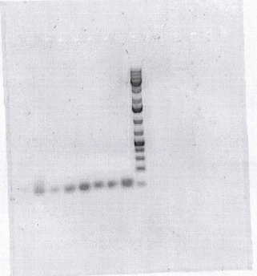
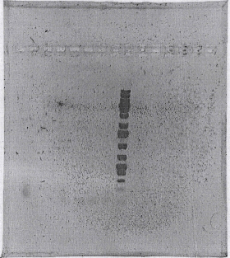
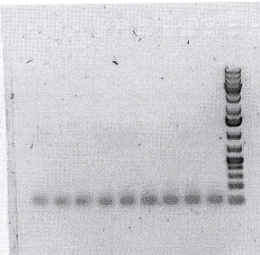
PCR Failing for MK3
Failed
11-14-2018
11-21-2018
11-26-2018
12-3-2018
Worked

Slide 14
Trouble Shooting PCR for MK3
December 3, 2015
Adding DMSO – No Result
Varying DMSO – No Result
Steps to Troubleshoot:
1) Varying annealing temperature gradient in °C (60, 58.9, 57, 54.1, 50.5, 47.9, 46, 45)
2) Use different source template at same gradient as above
3) Add DMSO at same gradient as above
Results: Worked for all 3. Temperature was Issue.

Slide 15
Transformation and miniprep of plasmid vector and insert vector with GOI
Amplification of GOI using PCR and Primers
Digest of Plasmid Vector, Purification, Phosphatase Treatment
Purification of PCR Reactions, Restriction Digest of PCR, and Purification
Ligation
Transformation
Pick and Grow Colonies
Miniprep and Restriction Digest

Slide 16
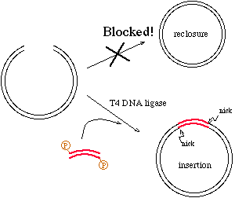
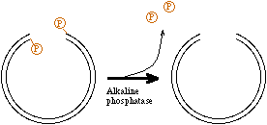
Digest, Purify, Phosphatase Plasmid Vector
Digest with same restriction enzymes to create sticky ends for insert to attach
Purify the digested plasmid so that we get rid of traces of undigested vector
Treat with Phosphatase
Prevents reannealing of circular vector during ligation
Ensures only insert with phosphate ends can anneal inside vector.
http://escience.ws/b572/L6/L6.htm

Slide 17
Transformation and miniprep of plasmid vector and insert vector with GOI
Amplification of GOI using PCR and Primers
Digest of Plasmid Vector, Purification, Phosphatase Treatment
Purification of PCR Reactions, Restriction Digest of PCR, and Purification
Ligation
Transformation
Pick and Grow Colonies
Miniprep and Restriction Digest

Slide 18
Purify, Digest, Purify Insert GOI
Need to Purify to remove polymerase enzyme and buffer
Digest so that we isolate the gene of interest and remove primers
Purify again so that we can remove digestion enzymes to allow for better ligation ability

Slide 19
Transformation and miniprep of plasmid vector and insert vector with GOI
Amplification of GOI using PCR and Primers
Digest of Plasmid Vector, Purification, Phosphatase Treatment
Purification of PCR Reactions, Restriction Digest of PCR, and Purification
Ligation
Transformation
Pick and Grow Colonies
Miniprep and Restriction Digest

Slide 20

Ligation Process
Setup control
1:3 Ratio Vector to Insert
1:7 Ratio Vector to Insert
Formula for Insert
$Insert=Mass Plasmid ∗ \frac{Length Insert}{Length Plasmid} ∗Mole Ratio$
*All amounts in µL | Vector Only | 1:3 | 1:7
pUC19 Vector | 1.82 | 1.82 | 1.82
EGFP Insert | 0 | 0.38 | 0.89
Ligase 10x Buffer | 2 | 2 | 2
H₂O | 15.18 | 14.8 | 14.29
DNA Ligase | 1 | 1 | 1

Slide 21
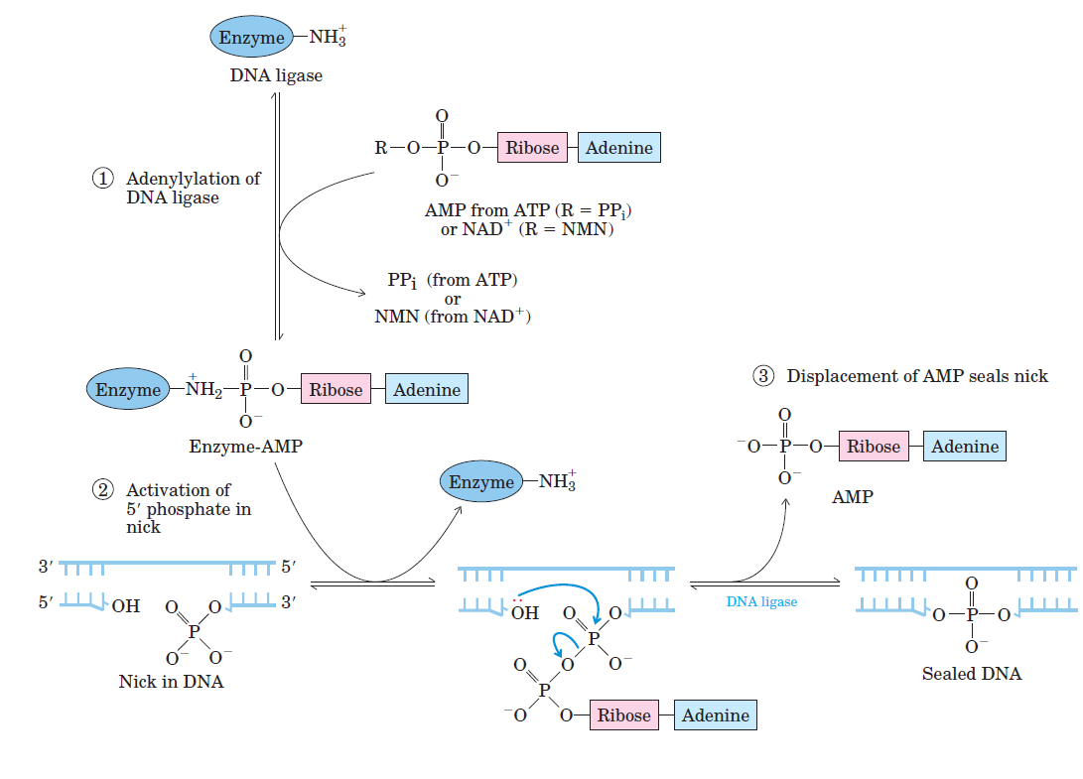
Ligation Mechanism
* Ligase uses a special lysine amino acid in addition to ATP/NAD+ (nicotinamide adenine dinucleotide) cofactor
http://easylifescienceworld.com/wp-content/uploads/2018/05/a-1.png

Slide 22
Transformation and miniprep of plasmid vector and insert vector with GOI
Amplification of GOI using PCR and Primers
Digest of Plasmid Vector, Purification, Phosphatase Treatment
Purification of PCR Reactions, Restriction Digest of PCR, and Purification
Ligation
Transformation
Pick and Grow Colonies
Miniprep and Restriction Digest

Slide 23
Transformation
We proceed with same process when transforming pUC19 vector
Add 120 IPTG and X-gal to ampicillin agar plates
IPTG induces functional β-galatosidase enzyme activation
If β-galatosidase is produced, X-gal hydrolyzes and dimerizes to make blue pigment
The insert vector is inserted within the MCS which changes the sequence and therefore disrupts the gene expression within the lacZ operon.
After plating and incubation we will see that the colonies that are blue did not take up the EGFP vector in the MCS while the white colonies were successful.

Slide 24
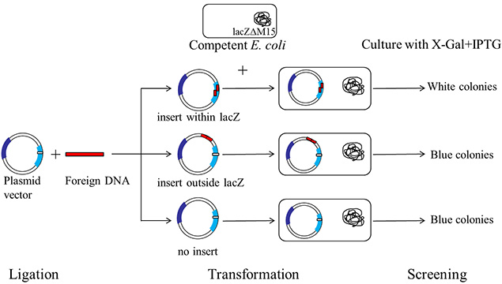
Transformation
https://www.sigmaaldrich.com/technical-documents/articles/biology/blue-white-screening.html

Slide 25
Transformation and miniprep of plasmid vector and insert vector with GOI
Amplification of GOI using PCR and Primers
Digest of Plasmid Vector, Purification, Phosphatase Treatment
Purification of PCR Reactions, Restriction Digest of PCR, and Purification
Ligation
Transformation
Pick and Grow Colonies
Miniprep and Restriction Digest

Slide 26
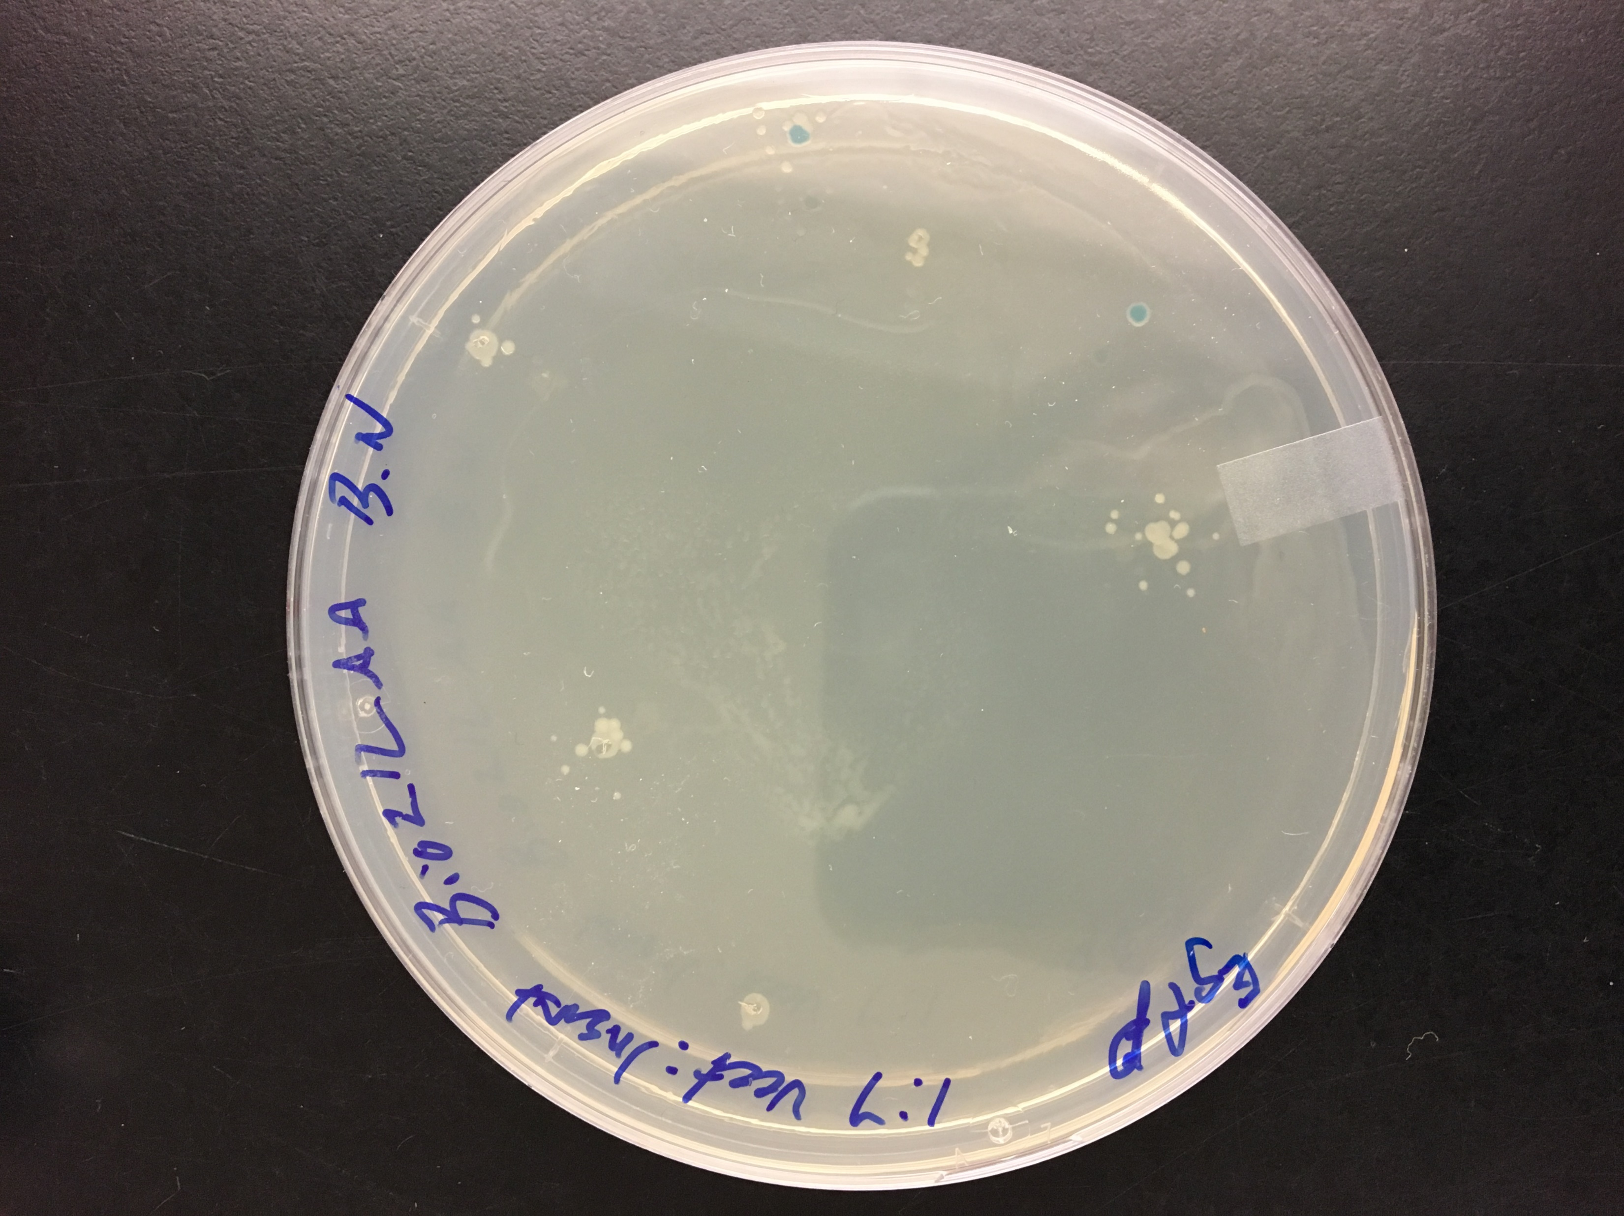
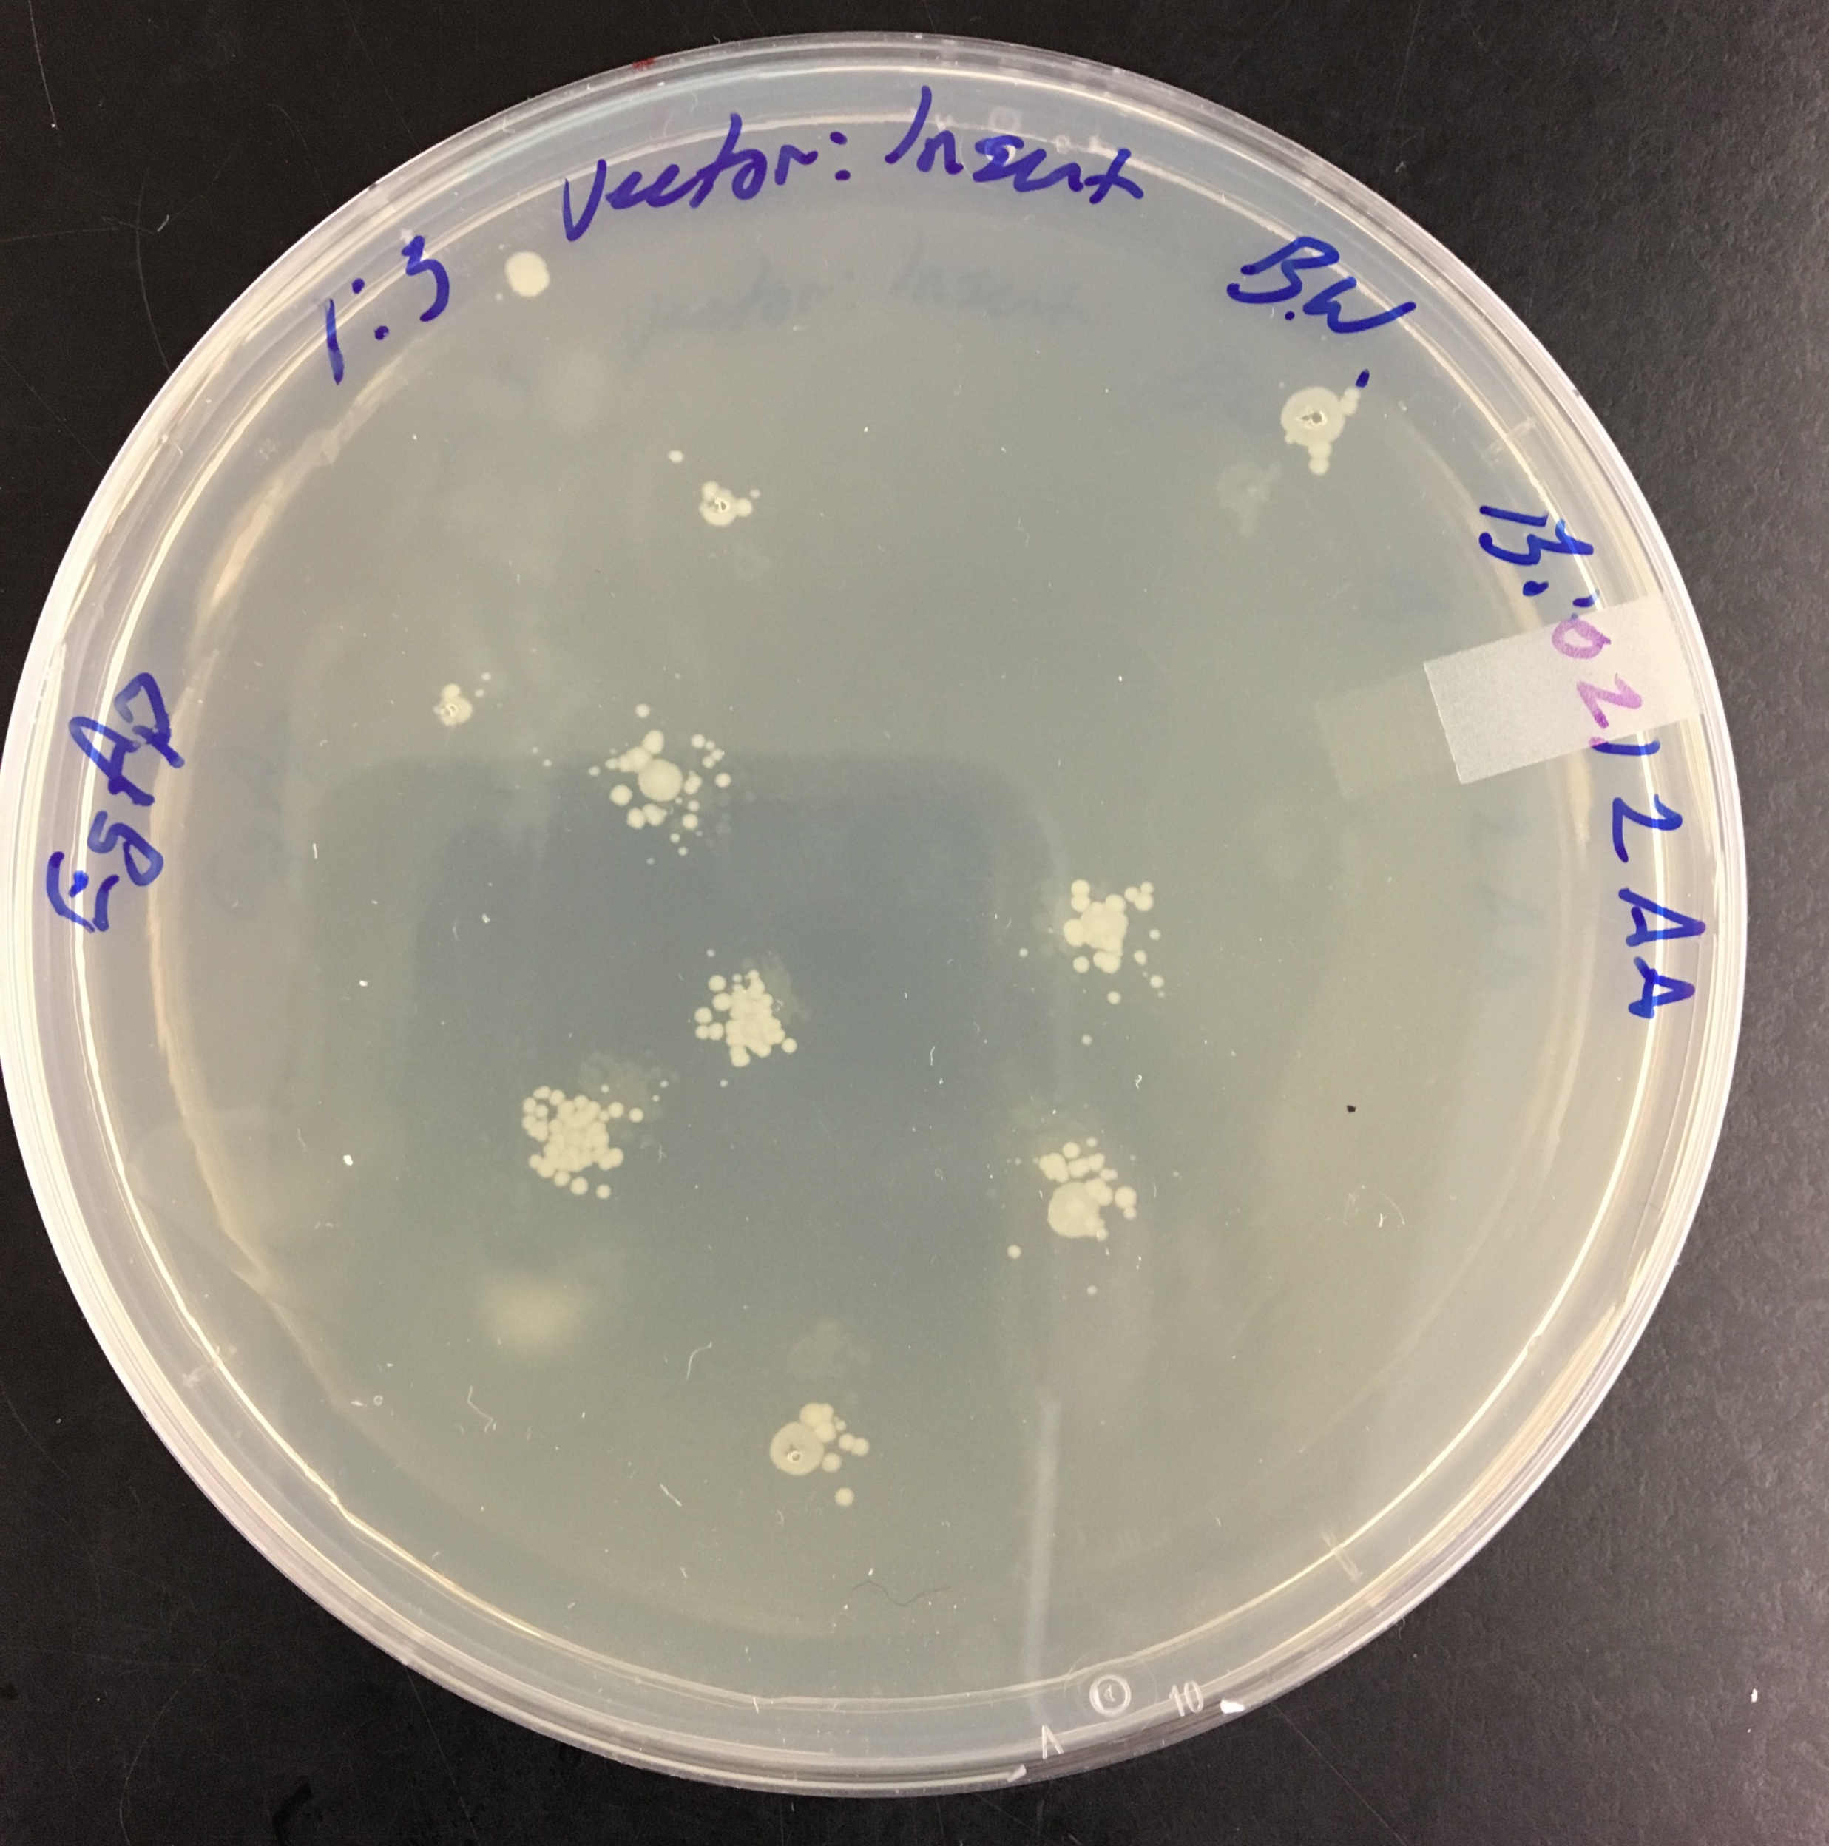
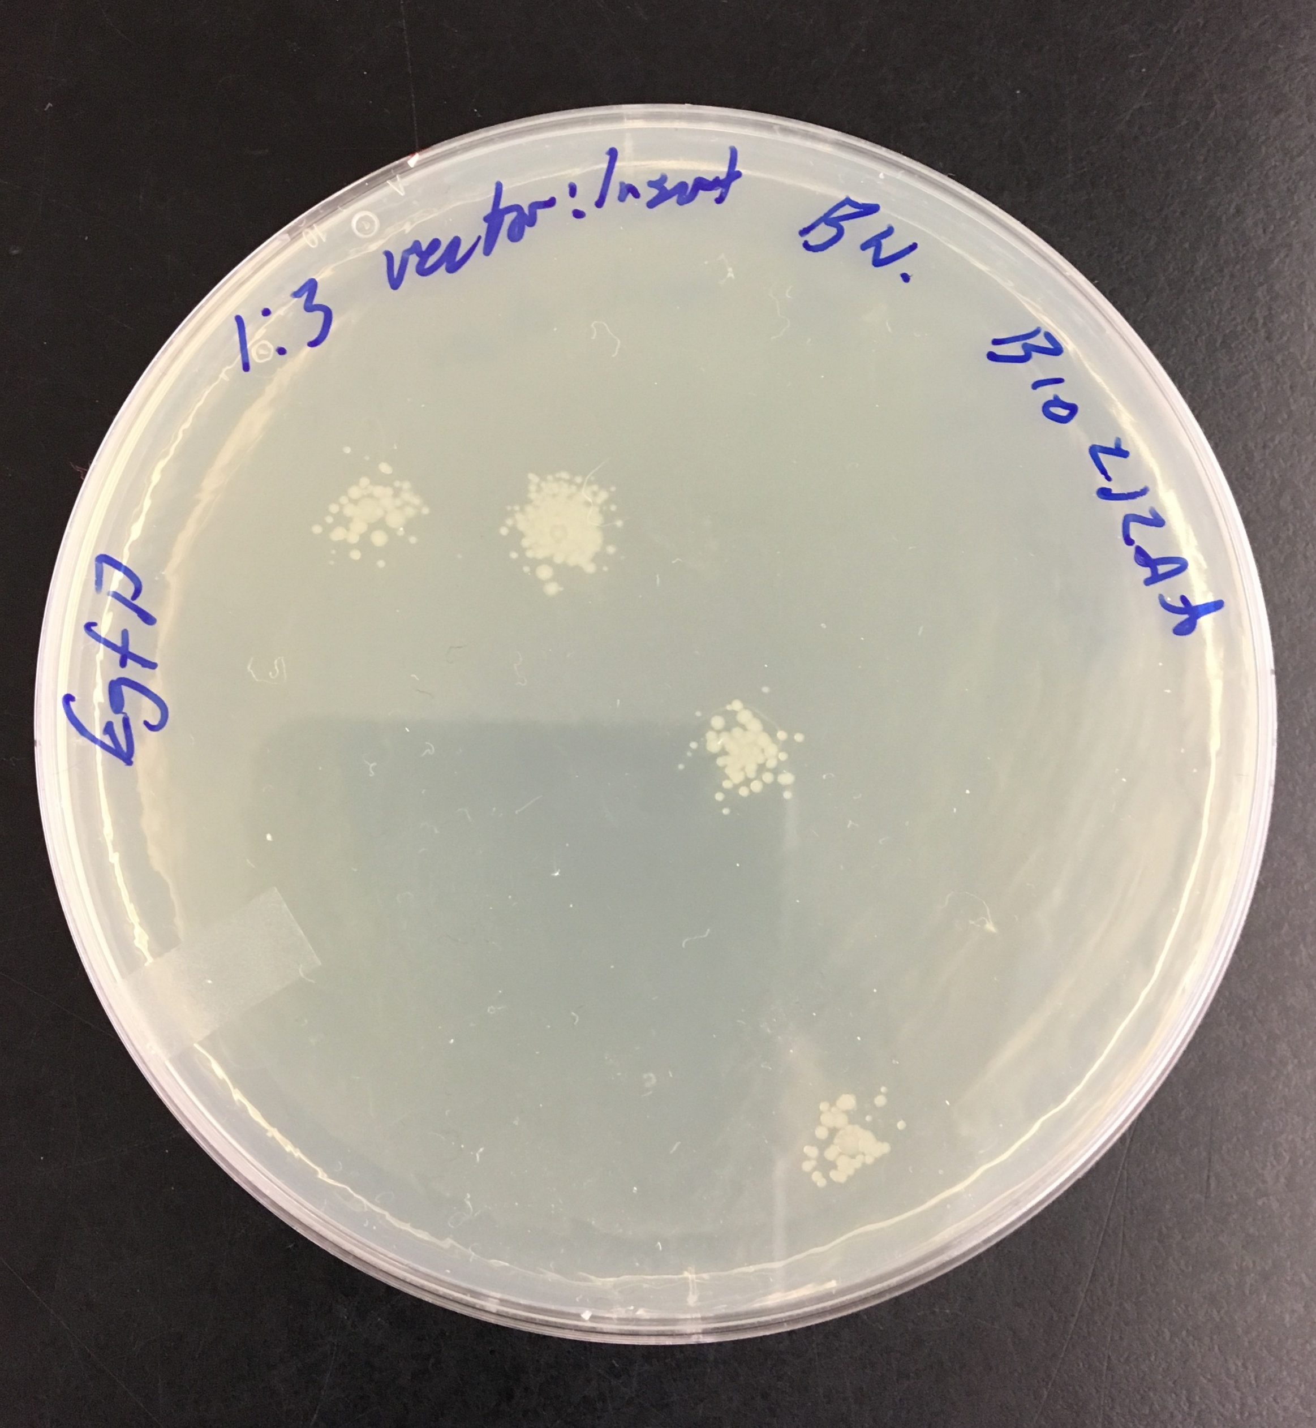
Pick and Grow Colonies
Pick white colonies that have taken up the EGFP insert
Grow in LB media over night

Slide 27
Transformation and miniprep of plasmid vector and insert vector with GOI
Amplification of GOI using PCR and Primers
Digest of Plasmid Vector, Purification, Phosphatase Treatment
Purification of PCR Reactions, Restriction Digest of PCR, and Purification
Ligation
Transformation
Pick and Grow Colonies
Miniprep and Restriction Digest

Slide 28
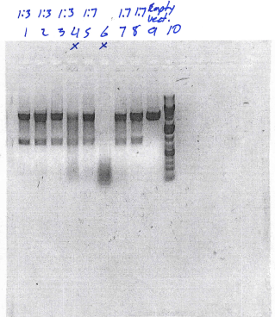
Miniprep and Restriction Digest
Follow miniprep process
Isolate Plasmid DNA from Bacteria DNA
Digest plasmid with restriction Enzymes:
EcorR1 and BamH1
Run on gel to confirm there is a band at length of EGFP vector insert (see red arrow)
Show band for EGFP in lanes 1, 2, 3 for 1:3 ratio and lanes 5, 7, 8 for 1:7 ratio

